Slide 1
Group 5
CAPSTONE PROJECT
VIETNAMESE SIGN
LANGUAGE RECOGNITION

Slide 2

Introduction
Group member :
Nguyễn Hữu Kỳ Long – Team leader
Nguyễn Đình Tân – Team member
Nguyễn Xuân Ý – Team member
Lê Phương Bình – Team member
Supervisor :
Mr. Đỗ Đức Minh Quân

Slide 3
Outline
Scenario problem
Our solution
System Architectural Design
System processes
Recognition experiment
Advantages and Disadvantages
Future plan
Features and Demo
System Features

Slide 4




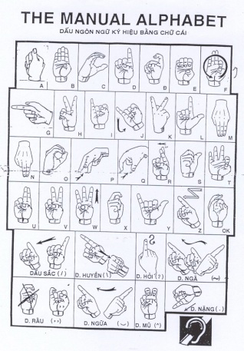
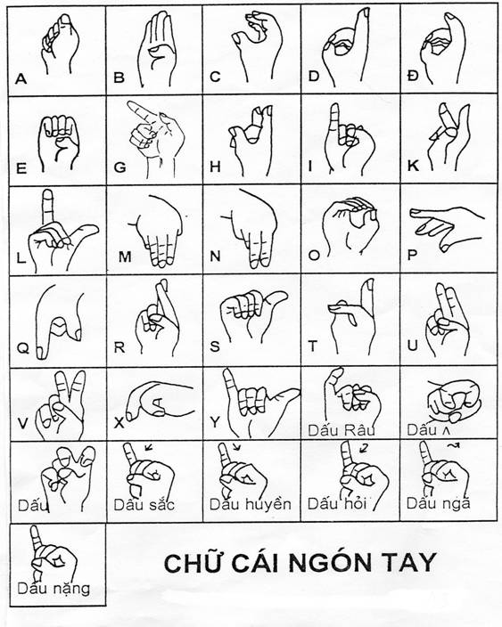

Scenario problem
Communication is extremely important
Dumb Person
Hand sign
You are not able to get hand sign language
Difference between hand sign languages

Slide 5


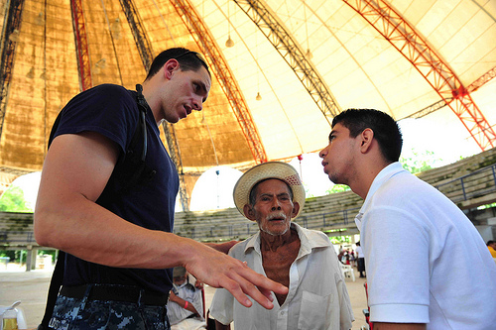
Our solution
Pen and Paper
Simple symbols
Translator

Slide 6

Our solution
Can capture hand signs
Can show meaning
of hand signs
Can recognize hand signs

Slide 7


System Features
Hand Sign Language Recognition
Learning Hand Sign Language
Portable System

Slide 8
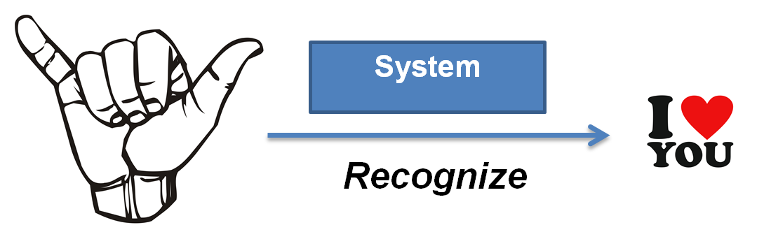
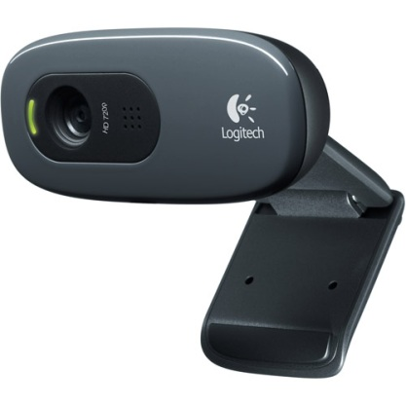
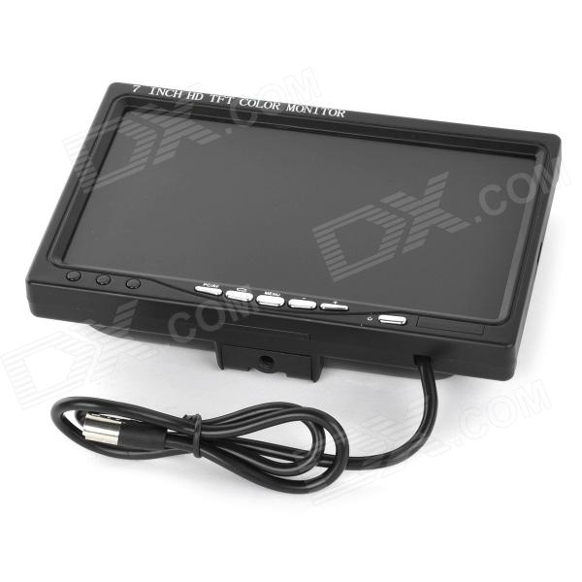
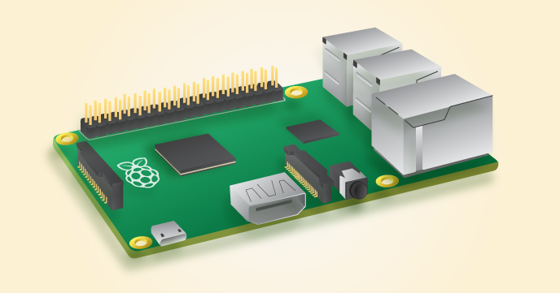
System Architectural Design
Logitec C270h camera
Raspberry Pi B2
7 Inch TFT LCD Monitor

Slide 9

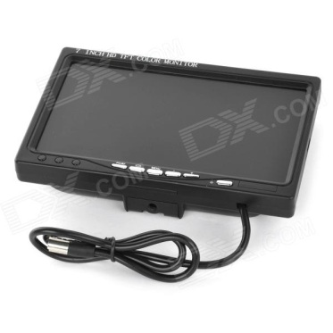
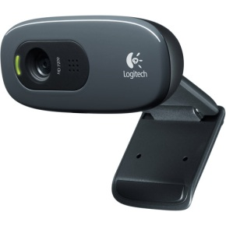
System Architectural Design
USB port
Ram 1GB
Linux OS
Ethernet port
40 GPIO ports
Full HDMI port
4 USB ports
HDMI port
Hi-Speed USB 2.0 certified
Photo : Up to 3.0 megapixels
Require 512 MB
Support Linux OS
7 inch
HDMI port

Slide 10
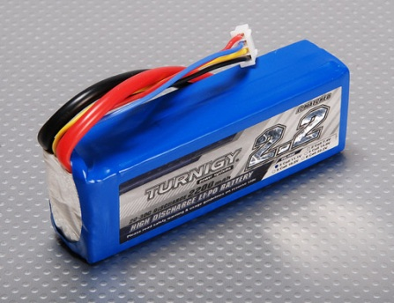
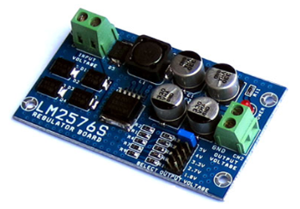
System Architectural Design
Portable System
Power supply 5~12V - 2A
Lipo Battery
Minimum Capacity: 2200mAh
Configuration: 3S1P / 11.1v / 3Cell
Constant Discharge: 20C
Peak Discharge (10sec): 30C
Micro USB
Power supply 5V - 2A
LM2576ADJ - 3A UNI REG Board
UNI-REG board allows changing voltages from 7-23V AC (or 9-32V DC) to 5V, 4V, 3.3V, 2.7V or 1.8V.
Circuit Board using LM2576 - Step-Down Voltage Regulator.
On-board screw-terminals are available for easy connection.

Slide 11
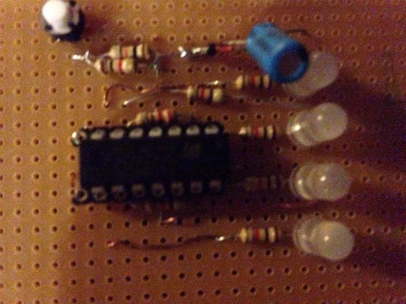
System Architectural Design
Portable System
GPIO Port
Circuit display the battery capacity via LED

Slide 12
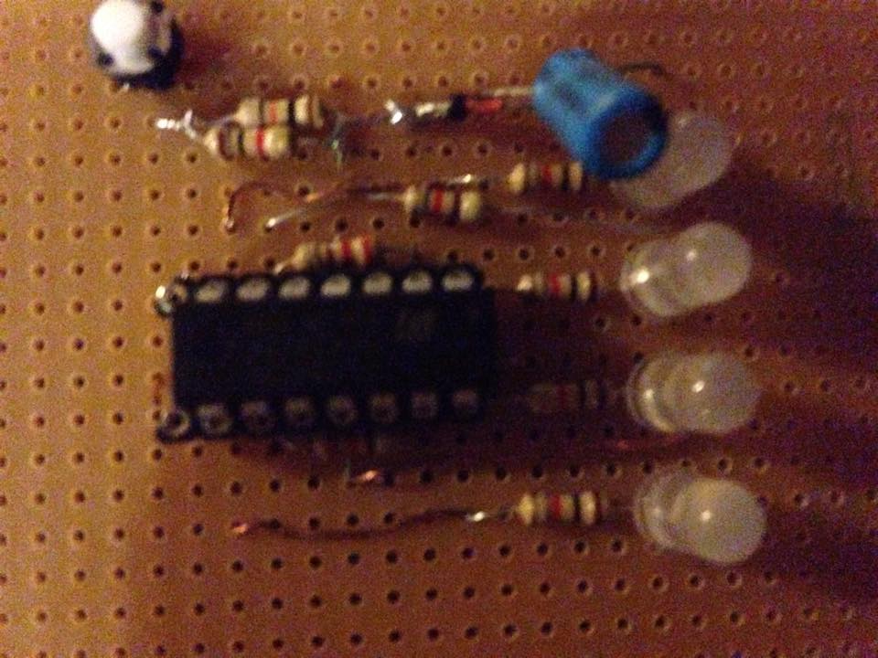
System Architectural Design
Circuit display the battery capacity via LED
LT084
1 diode zener 5.1v (1N4733)

Slide 13
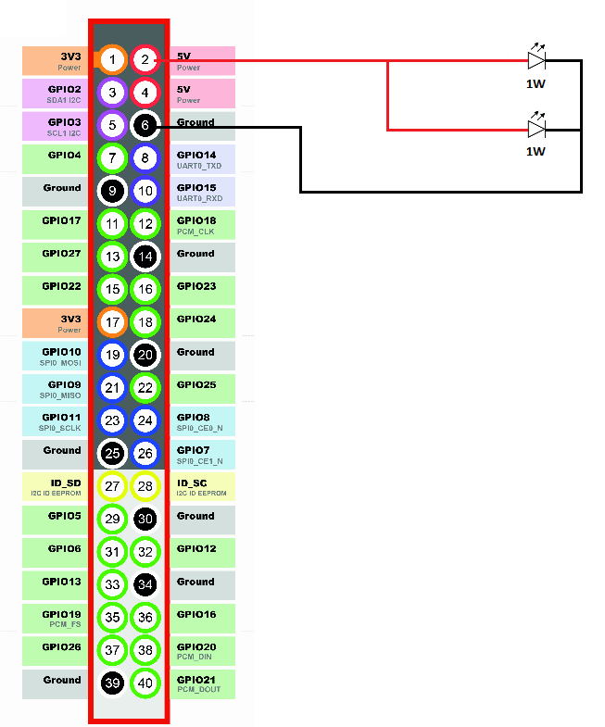
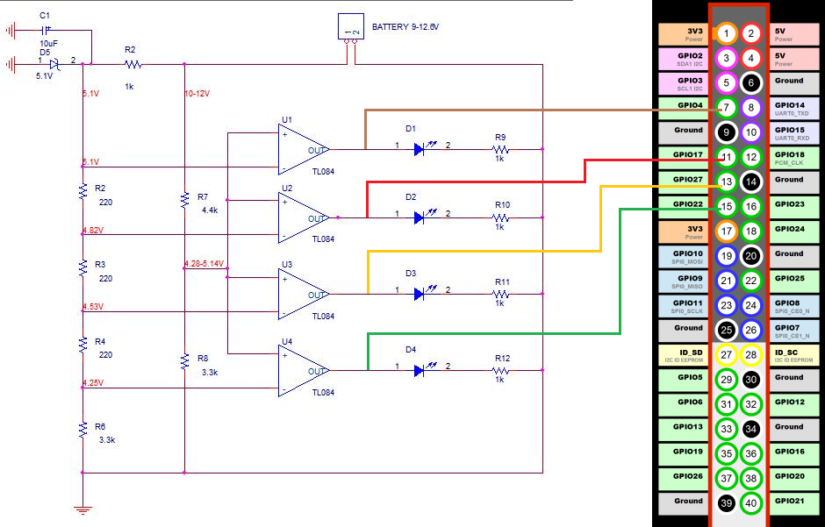
Overview components (Cont)
Connection components

Slide 14
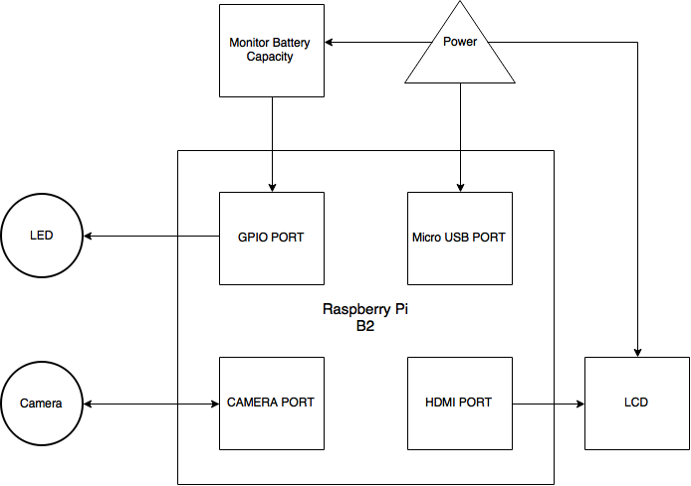

System overview
Notes:
Chi tiết -> Tổng quát

Slide 15

System Processes
Hand Sign Recognition Process
Battery Capacity Notify Process

Slide 16
Hand Sign Recognition Process
Common Recognition Problem
X
Input
f(x)
Y
Output
Ideal Action Classification Formula
≈
g(x)
Hypothesis Classification Formula
Machine Learning, Support Vector Machine

Slide 17
Hand Sign Recognition Process
Support Vector Machine
TARGET FUNCTION
f(x): X -> Y
IMPORTANT
TRAINING SAMPLES
(X-1,Y-1),(X-2,Y-2), …, (X-N,Y-N)
LEARNING MODEL
SVM
FINAL CLASSIFICATION FORMULA
g ≈ f

Slide 18



Hand Sign Recognition Process
Support Vector Machine
TRAINING SAMPLES
(X-1,Y-1),(X-2,Y-2), …, (X-N,Y-N)
K

Slide 19



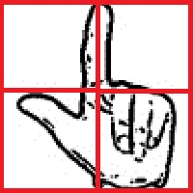
Hand Sign Recognition Process
Features Extraction
Zoning features
- The density of black pixels for every single zone which is divided in an image frame.
For example:

Slide 20



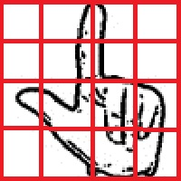


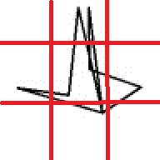

Hand Sign Recognition Process
Zoning features

Slide 21

Hand Sign Recognition Process
Features Extraction
Ratio between height and width

Slide 22

Hand Sign Recognition Process
Features Extraction
Ratio between radius of hand palm and height

Slide 23
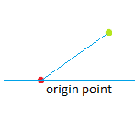
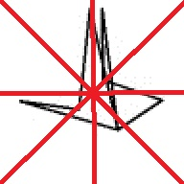
Hand Sign Recognition Process
Features Extraction
Degree features

Slide 24

Hand Sign Recognition Process
Convert to binary image

Slide 25


Hand Sign Recognition Process
Background color Subtraction

Slide 26

Hand Sign Recognition Process
Image Preprocessing
Extract Features
Recognition by SVM
Output recognition result
Notes:
Nhất quán cách dùng từ
Bước 1 : tiền xử lí

Slide 27

Hand Sign Recognition Process
Output Recognition Result
Show text to LCD screen
Vocalize through the speakers lcd

Slide 28
Battery Capacity Notify Process
Receiving signals from Notify Battery Capacity Circuit
Display battery capacity in LCD
Show warning when low capacity.

Slide 29
Battery Capacity Notify Process
Receiving signals from Notify Battery Capacity Circuit
Use bcm2385 library
Process every 5 minutes

Slide 30

Recognition experiment
Training sample: 100 samples of each hand signs
Test sample: 10 samples of each hand signs`
 | Percent Of Accuracy
A | 100%
B | 100%
C | 100%
D | 100%
DD | 100%
E | 100%
G | 100%
H | 100%
I | 100%
K | 100%
L | 100%
M | 100%
N | 50%
O | 100%
P | 100%
Q | 100%
R | 100%
S | 100%
T | 100%
U | 100%
V | 100%
X | 100%
Y | 100%
backhand | 100%
SAC | 100%
HUYEN | 100%
RAU | 100%
MU | 100%
Total | 98%
 | N | R | Result
N | x |  | TRUE
N | x |  | TRUE
N |  | x | FAIL
N | x |  | TRUE
N |  | x | FAIL
N | x |  | TRUE
N |  | x | FAIL
N |  | x | FAIL
N | x |  | TRUE
N |  | x | FAIL

Slide 31
Advantages and Disadvantages
Advantages
Quick and easy communicate for dumb person.
Train for person who don’t know about mute language.
People get used to the dumb language easily.
Disadvantages
This solution needs stable environment (light, background) and some accessories.
This solution can not solve the problem about hand motion language.
Standardized for hand sign language.
In some cases, this solution does not work really exactly with the hands have weird characterize.

Slide 32
Future plan
Recognize hand signs with motion
Manage hand sign language database
Improve the efficiency of the recognition of many different environments

Slide 33
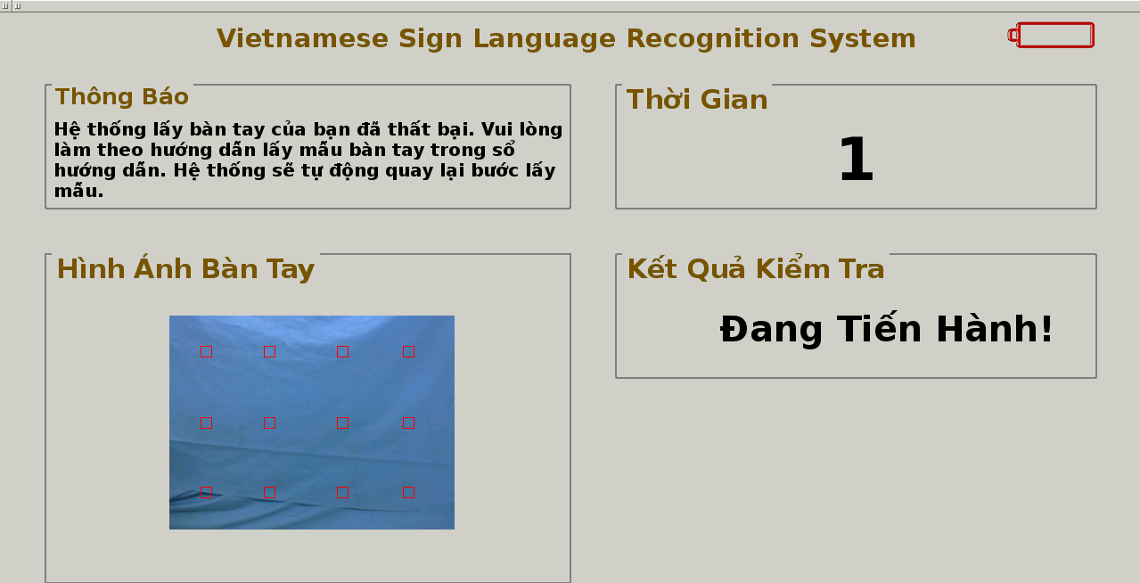
Demo

Slide 34
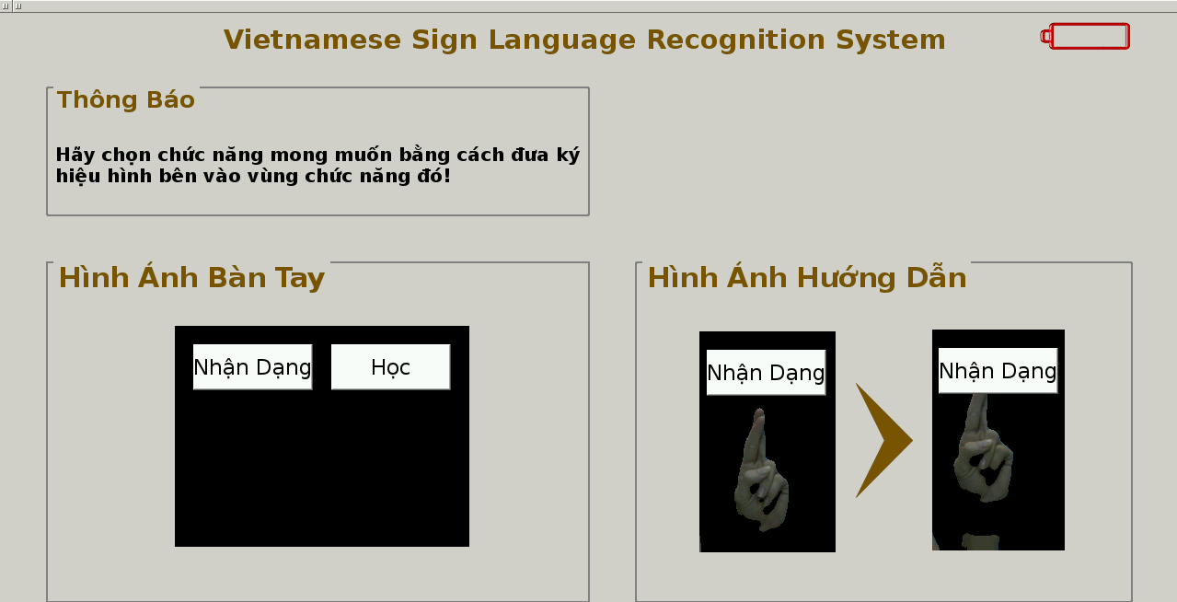
Demo

Slide 35
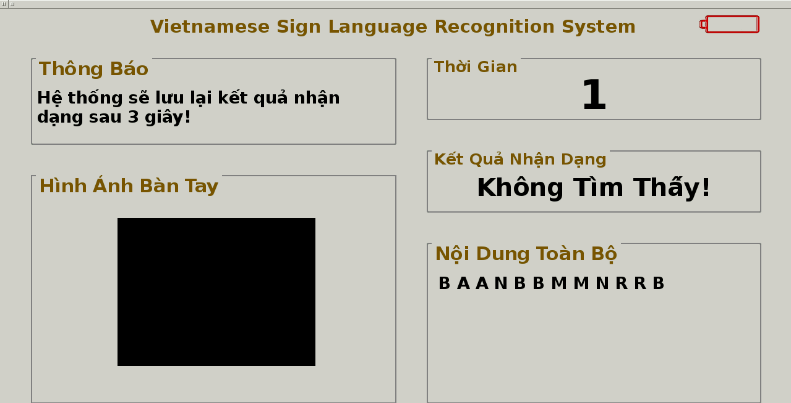
Demo

Slide 36
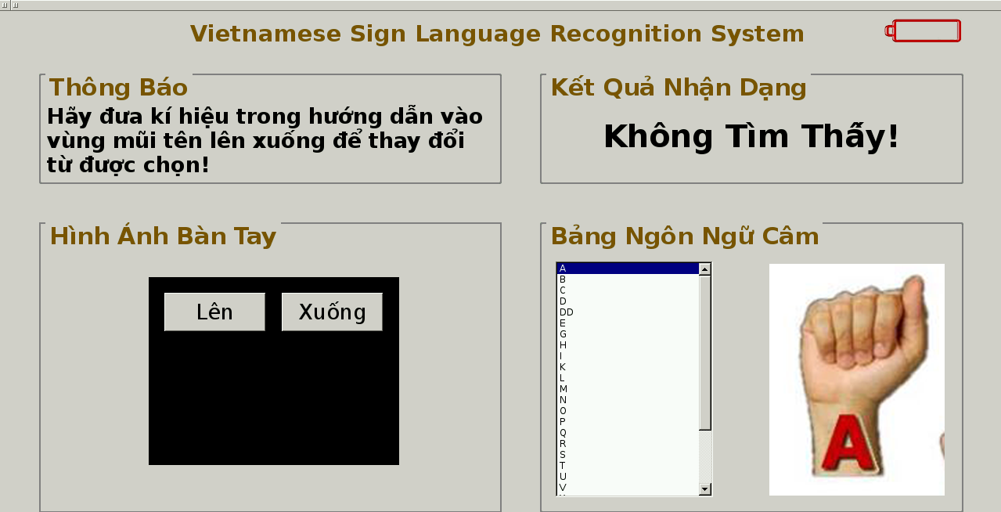
Demo

Slide 37
Thank You Q & A

